Slide 1
Introduction to Research Grants and Contracts Office
Juan Vidal
Deputy Head of Research Grants & Contracts

Slide 2
Summary
The Research Grants & Contracts Office
Applying for external research grants
Where to find information on funding opportunities

Slide 3
Research Grants & Contracts Office
The RGCO, part of Finance Department, provides administrative, financial and support services related to externally funded research projects
Pre award: funding information, help with applications, approval, contract negotiation
Post award: project accounting, approval of posts funded by research grants/contracts, allocation of overheads, financial reporting, contracts with partners
Policy development
Management information
Training and events

Slide 4
RGCO main SSHP contacts
Liz Francis
Head of RGCO
Juan Vidal
Deputy Head
Sharon Bell
Research Accounts Officer
Urvi Makwana
Research Support Officer
Rassi Pelpola
Research Support Officer
George Eyre
Research Support
Officer
Faheem Malik
Research Accounts Assistant
Marion Barthram
Research Grants Assistant

Slide 5
Research funding information
Information on main research funding bodies available on RGCO website
Details of all calls posted on RGCO website
Section specifically for early career fellows
Funder search facility available through ResearchProfessional.com
Contact us for advice

Slide 7
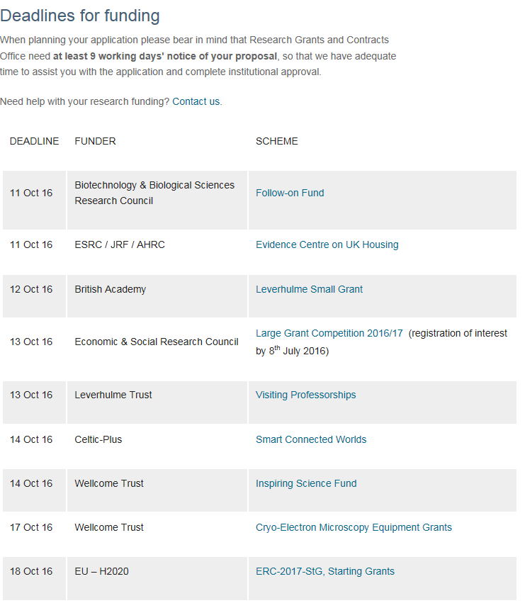

Slide 8
RGCO: Help with applications
Guidance on funders’ terms and conditions, submission processes, eligibility
Copies of previous successful applications
Budgets: salaries and overhead-type costs – using the web-based costing system pFACT
Proposal writing: Assist with identifying suitable funders, review lay summaries/justifications of resources
Approval: using workflow system on pFACT

Slide 9
Application approval
All research funding applications must be approved by Birkbeck prior to submission
This includes applications that are led by other institutions – we still need to approve our part
Internal approval on pFACT system
Final copy (or near final draft) of application required for approval
First approval step for a fellowship is done by the “Mentor” on the fellow’s behalf
Each approver (RGCO, Exec Dean, College Secretary) should be given 3 working days to review
All stages to be completed prior to submission to funder

Slide 10
pFACT Username will be you College username
Password is unique to pFACT
RGCO can reset your password or provide
training on pFACT
You need to use VPN to access pFACT from outside
the College
http://pfact.bbk.ac.uk/login.aspx

Slide 11
Internal peer review
Demand Management: institutions to pre-evaluate bids with the aim of submitting fewer, higher quality proposals – driven by RCUK
All applications require internal peer review
Some schemes have institutional competition (i.e. Leverhulme Early Career Fellowship)
Need to allow adequate time for this

Slide 12
Submitting applications
Many funders including Research Councils, British Academy, Leverhulme Trust, Wellcome Trust have a two-stage submission process. BBK approval done by RGCO
Applicant submits and then institution approval required prior to scheme deadline

Slide 13
Useful links
Information on applying for research funding
http://www.bbk.ac.uk/staff-information/research
Funding deadlines
http://www.bbk.ac.uk/staff-information/research/funding-deadlines
Early Career researcher page
http://www.bbk.ac.uk/staff-information/research/early-career-researchers
Research Professional
https://www.researchprofessional.com/0/rr/home

Slide 14
Questions?
Juan Vidal
Deputy Head of Research Grants and Contracts
j.vidal@bbk.ac.uk
0207 380 3141

