Slide 1
Networking in academia
Rosie Campbell

Slide 2
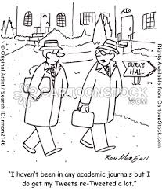
What is networking?
Let’s start with what it needn’t be:
Arranging 8:30am breakfast meetings
Seeking out and introducing yourself to the most important person in the room
Speaking to everyone at a reception
You don’t have to ‘work the room’
Instead networking can be:
Attending conferences in your field
Exchanging ideas with likeminded people
Seeking out individuals whose work you are interested in (when you have a genuine question or real research finding)
In short networking doesn’t have to be painful

Slide 3

Where to start
Be in the room
Read papers in advance where possible
Join a professional association
Join a graduate network
Identify who to meet in advance and read their recent work. Have a clear project and some findings, email to follow up with a link to a paper or blog
Give papers, but do you best to make sure they are ready and practice your presentation out loud.
Attend AGMs, drinks receptions, take pals from the graduate network
If it is your first time attending a conference can you be introduced to anyone in advance?
Make use of your supervisor’s contacts where appropriate
Be realistic about when to give your first paper, not too soon but when feedback is still useful

Slide 4
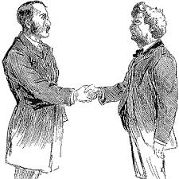
With whom should you network?
Your peers
Researchers in your field
Journalists?
Practitioners?

Slide 5
Why should you network?
To develop your ideas
To gain knowledge about your research area and discipline
To develop a network of peers for feedback and the sheer pleasure of finding other people who are as interested as you are in your subject
To gain name recognition for yourself in association with your subject area
To hear about opportunities

Slide 6
How should you network?
As yourself
Putting yourself in the right places with a good project and good presentation and being approachable
Helping others out

Slide 7
Conclusions
Creating an academic network is a core part of your job as a researcher. It provides you with the opportunity to share the findings of your research, learn about new developments in your field. It also can help you make sure that your research has an ‘impact’.

