Slide 1
Building your academic skills
GET AHEAD POSTGRADUATE PROGRAMME 2016
Sara Steinke
s.steinke@bbk.ac.uk

Slide 2
Aims
Introduction to this series of academic skills workshops
Identify the academic skills that are required for postgraduate study
Reflect on - and undertake an audit of - your existing academic skills
Help with identifying the academic skills you might require help and support with - and where to get help

Slide 3
Class activity
Introduce yourself to another student, and find out what type of postgraduate study they are undertaking.
Find out the factors involved in their decision to study a particular course at Birkbeck.
Job opportunities/promotion/change of career
Desire to return to learning
Financial concerns
Time constraints
Course subject
Birkbeck’s reputation/location/time

Slide 4
Get Ahead
6 September - Staying Organised
13 September - Reading and Note-taking
20 September - Critical Thinking
27 September - Academic Writing
Tuesdays 6.30-8pm in B35

Slide 5
“... those generic and transferable skills which underpin the learning development of undergraduate and taught postgraduate students in HE, enabling them to be confident, independent critical thinkers and reflective learners.” (Leeds University Library, 2010)

Slide 6
Cottrell, S. The Study Skills Handbook
C - Creative
have the confidence to use your individual strategies and styles, apply
imagination to your learning
R - Reflective
sit with your experience, analyse and evaluate your own performance
and draw lessons from it
E - Effective
organise your space, time, priorities, state of mind and resources to
the maximum benefit
A - Active
be personally involved, do things, physically and mentally in order to
make sense of what you learn
M - Motivated
be aware of your desired outcomes using short and long-term 'goals'

Slide 7
Importance of academic skills
Crucial to being an efficient, effective, active
learner
Interrelated
Go hand in hand with academic content
Transferable to the workplace - soft employment
skills
Expected of you in Higher Education -
even more so in postgraduate study

Slide 8
Postgraduate skills
Read more widely and critically
Demonstrate academic judgement
Gather and process evidence
Apply appropriate research methodologies
Present your findings in an appropriate manner
Work more independently
Work with a supervisor

Slide 9
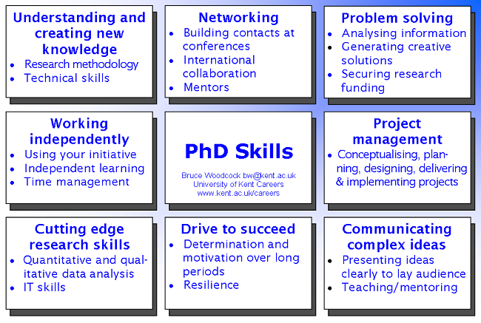

Slide 10
Time management and organisation
Do you:
have strategies to help you plan and organise
your time?
know how much time you have available for
your studies?
know when and where you study most
effectively?
keep a diary so you know when to attend
lectures/assignments are due and have a
prioritised to-do list?

Slide 11
Reading
Can you:
select and use different reading strategies?
think about what you need to find out before you start reading?
critically evaluate reading?
deal with new vocabulary?

Slide 12
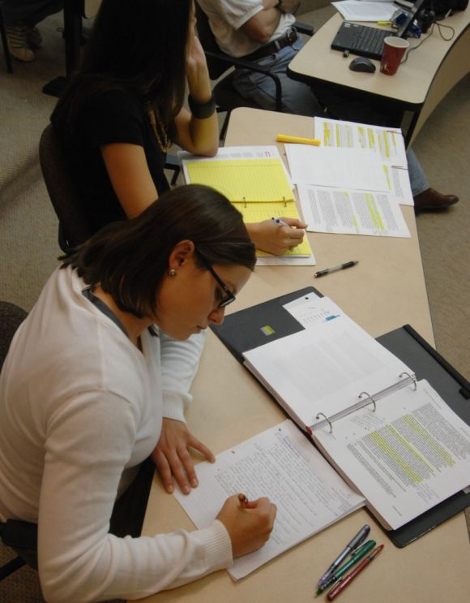
Note-making
Can you:
make effective notes when reading?
make effective notes when listening?
use more than one note-making technique?
do you have a way of organising your
notes?

Slide 13
Critical thinking
Can you:
distinguish between fact and opinion?
draw conclusions based on evidence?
account for different points of view and
detect bias?
develop a sound academic argument?

Slide 14
Writing
write in an academic style?
link your ideas in a logical order?
write using a clear sentence structure, effective paragraphs and correct grammar?
integrate your reading into your writing to develop your own argument?

Slide 15
Help for postgraduate study
Biddam, J. (2014), Succeeding with your Master's
Dissertation: A Step-by-Step Handbook 3rd edition,
(OUP)
Hart, C. (2004), Doing Your Masters Dissertation,
(Sage)
Wisker, G. (2007) The Postgraduate Research
Handbook: Succeed with your MA, MPhil, EdD and
PhD 2nd edition (Palgrave)

Slide 16
Recap
Introduction to this series of academic skills workshops
Identify the academic skills that are required for postgraduate study
Reflect on - and undertake an audit of - your existing academic skills
Help with identifying the academic skills you might require help and support with - and where to get help

