Slide 1
GET AHEAD POSTGRADUATE SUMMER PROGRAMME 2016
Get Ahead in postgraduate critical thinking
Sara Steinke s.steinke@bbk.ac.uk

Slide 2
Aims
What is meant by critical thinking in HE - and its importance for postgraduate study
Gain knowledge of critical questions for becoming a critical thinker
Identify what is meant by academic argument
Reflect on how you can develop your critical thinking skills

Slide 3
Think about the following
Critical thinking occurs in everyday life. Many everyday activities require you to seek information, analyse alternatives, evaluate the alternatives in relation to your requirements and reach some conclusion.
Identify 5 ‘Critical thinking: Knowledge, skills
and attitudes’ (see handout) that you bring to
your studies.

Slide 4
What is critical thinking? (1) Cottrell, S. The Study Skills Handbook
Stand back from the information given
Examine it in detail from many angles
Check whether it is accurate
Check each statement follows logically
Look for possible flaws in the reasoning/ evidence/conclusion
Compare the same issue from point of view of theorists/writers

Slide 5
What is critical thinking? (2)
Explain why different people arrive at different conclusions
Argue why one opinion/result/conclusion is preferable to another
Be on guard for devices that encourage the reader to take questionable statements at face value
10. Check for hidden assumptions
11. Check for attempts to lure the reader into agreement

Slide 6
Critical thinking involves
Agreeing or disagreeing with a point of view
Conceding that an argument may have this merit but…
Comparing different view points
Proposing a different point of view
Bringing together differing points view by adding a new perspective
Applying your knowledge to different contexts
Coming to a conclusion and being able to make inferences

Slide 7
Critical thinking as a process
Stage 1 Analyse (take apart) | Stage 2 Synthesise (put together) | Stage 3 Evaluate (create your own)
Look at - and understand - the key points, arguments and underlying assumptions | Pull together different arguments to express an idea | Criticise views you do not agree with
Compare and contrast arguments | Make logical connections to serve one argument | Weigh up and come to your own judgement
Look at the different components of the argument and how they relate to each other |  | Justify your view with the evidence you have found and develop your own arguments

Slide 8
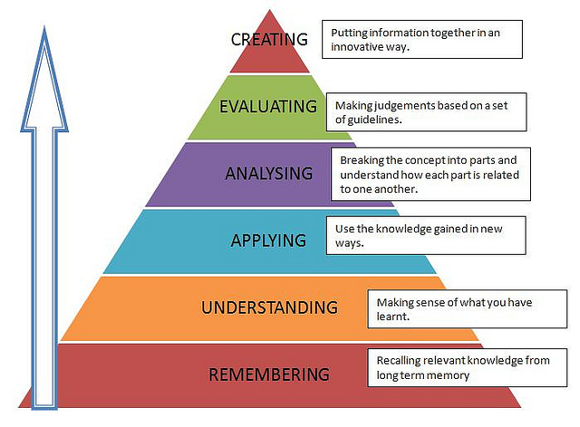
Bloom’s revised taxonomy

Slide 9
Importance of critical thinking
Cornerstone of all academic activity
Helps you to adopt a critical distance towards yours and other peoples work/ideas
Means of pushing the boundaries of knowledge forward by examining messy, grey areas
Goes hand-in-hand with academic content
Essential for developing other academic skills
Promotes an (pro)active, independent and reflective approach to learning
Soft employment skill - transferable to the workplace

Slide 10
Importance of critical thinking for postgraduate study (1)
Greater engagement with methodology
Writing a literature review
Knowledge management/problem solving in the research process
Reflected in the structure of a dissertation
Related to improved motivation, time management - and battle against procrastination, isolation

Slide 11
Importance of a critical thinking for postgraduate study (2)
Preparing for/defending your thesis in your viva
Presentation skills - conference/teaching
Research ethics
Managing discussion in small groups
Writing for different audiences
Creative thinking

Slide 12
Critical thinking at university
What is the main argument of the article?
What are the reasons given to justify the argument?
What evidence has been used?
What do you know about the author?
What audience is the author addressing?
What sources has the author used?
You have been asked
to read an article in
preparation for a
lecture. What
questions might
you ask in order to
think critically about
the article?

Slide 13
1. What is the main argument or thesis of the text?
Look at the introduction or first two paragraphs and check the conclusion
A well written piece should tell you the main argument, thesis or position
These first paragraphs should also tell you the parameters or timeframe if relevant, and the interpretation and final conclusion of the author

Slide 14
2. What are the reasons given to justify the conclusion?
Can you list them?
Are they well presented?
Is there a clear, logical line of reasoning?
Are the reasons given supporting the final conclusion?
What is your conclusion?
Has the writer included and considered
dissenting views?

Slide 15
3. What evidence has been used?
What facts or evidence is being presented?
Are these valid, up-to-day, relevant to the case?
Is the writer’s interpretation of these facts valid?
Does the evidence support the argument?
Is it an acceptable interpretation?
What points of view have not been
considered? Why?

Slide 16
4. What do you know about the author?
What do you know about the author’s background?
What are the author’s credentials/specialism? - has the author written other books/articles?
What are the author’s affiliations? - does the author have a vested interest in the topic?
Has the author a reputation for being provocative, controversial?

Slide 17
5. What audience is the author addressing?
Is the article published in an academic journal read by other scholars?
Is the author addressing a general well educated readership?
Is the article’s intention to introduce a topic to people who are new to the subject?
Is the author writing for a wider, cross-disciplinary readership?

Slide 18
6. What sources has the author used?
Check the footnotes, references and bibliography
Has the author used a wide range of sources?
Are there unusual, unexpected or new sources?
How narrow or wide a literature search did the author undertake?
Has the author concentrated on a particular type of sources?

Slide 19
Critical reading

Slide 20
Critical note-making
Active note-making techniques helps you to understand what you are reading
Be critical - ask questions as you take notes
Achieve a logical, objective interpretation of the argument
Helps you to defend your point of view against charges such as bias, lack of supporting evidence, incompleteness and illogical reasoning
Using critical thinking when you take notes and rigorously employing it when you construct your own line of argument will help you avoid these problems

Slide 21
In your written work you should always be trying to construct sound arguments. Unsound arguments will attract poor grades from assessors. Learning in Higher Education involves more than the memorisation of large amounts of information and its subsequent accurate regurgitation during examinations or assignments. In many subjects the process of assessment involves taking information and assembling, synthesising and re-arranging it into new patterns that both form sound arguments and solve the problems set in assignments titles and examination questions.
http://www.staffs.ac.uk

Slide 22
“A sound argument is a point of view that has been developed through the application of reasoning and critical analysis, drawing conclusions from the available evidence, and doing so using logic, objectivity, and other agreed intellectual standards.
An unsound argument, on the other hand, is a point of view that is in some way flawed. It could be that it is weak and unconvincing, or is based on an unbalanced analysis of the available evidence. It could also be that there is a mistake in reasoning - a so called logical fallacy.”
http://www.essex.ac.uk/

Slide 23
Resources for critical thinking
Cottrell, S. (2005) Critical Thinking Skills
Roy van den Brink-Budgen (2000) Critical Thinking for Students: learn the skills of
critical assessment and effective argument
Roy van den Brink-Budgen (2010) Advanced Critical Thinking Skills
Wallace, M. & Wray, A. (2011) Critical Reading and Writing for Postgraduates
https://he.palgrave.com/studentstudyskills/resources/images/criticalanalysis.mp3
12 minute audio file based on Cottrell’s Critical Thinking Skills
https://he.palgrave.com/studentstudyskills/page/critical-thinking/
helpful information on critical thinking skills on the Study Skills Website
http://www.bbk.ac.uk/mybirkbeck/get-ahead-stay ahead/skills/critical-thinking
http://www.bbk.ac.uk/mybirkbeck/get-ahead-stay-
ahead/academic_skills/critical_thinking
5 minute interactive tutorials supporting this Student Orientation programme
http://www.bbk.ac.uk/mybirkbeck/studyskills/course_timetable
academic skills workshops dealing with critical thinking skills 1, 2 and 3 - and
other academic skills - in greater detail

Slide 24
Recap
What is meant by critical thinking in HE - and its importance for postgraduate study
Gain knowledge of critical questions for becoming a critical thinker
Identify what is meant by academic argument
Reflect on how you can develop your critical thinking skills

