Slide 1
GET AHEAD POSTGRADUATE SUMMER PROGRAMME 2016
Get Ahead in postgraduate writing
‘In my experience the most important thing is to write the way they want. You can write all kinds of stuff you know about, but you don’t get good marks unless you write it the proper way.’ Northedge, (2007: 245)
Sara Steinke s.steinke@bbk.ac.uk

Slide 2
Aims
Importance of writing the way ‘they’ want
What is the ‘proper way’?
- conventions of academic writing
The writing process
Writing an essay
- analysing the question
- writing introductory, main body and
concluding paragraphs
Writing a dissertation

Slide 3
Why do you think writing gives students the most anxiety?
They have not written an essay in a long time.
They do not know what an academic essay looks like.
They miss deadlines as a result of poor time management.
They have no idea what is meant by an academic writing style.
Answer: A, B, C and D

Slide 4
Importance of writing the way ‘they’ want? (Northedge, 2007: 246)
Deepens your learning
Develops your writing skills
Doing yourself justice
Enables the reader to understand your point of view
Strengthens your powers of self-expression
Major medium through which your progress is assessed

Slide 5
Importance of academic writing for PG study
Postgraduate students are required to be independent, critical thinkers, and expected to contribute to the field of study
This influences postgraduate writing in 4 ways:
1. critical thinking
2. research
3. academic integrity
4. academic style

Slide 6
Critical thinking
Think independently
Provide original perspective on previous research
Make connections between ideas/between your work and other research

Slide 7
Research
Become aware of the current knowledge in your field
- deep and breadth
- synthesise information
- literature review
Expected to contribute personally to the knowledge in your field
- creative thinking
- presenting information in a new way, applying
previous research to new problems, proving a
thesis

Slide 8
Academic integrity
Give credit for intellectual property that you borrow
- paraphrasing, summarising, quotes,
referencing
Be familiar with intellectual property rights
- opportunities to produce original work
Be aware of research ethics

Slide 9
What is academic English?
What makes spoken or written English ‘academic’
is not the ideas, but the way the ideas are:
presented - in a logical order, with evidence to
support them, objectively
expressed - using formal language, using
specialist vocabulary, using words and phrases
that are expected in writing at university

Slide 10
Formality
Write in complete sentences (noun and verb; capital letters and full stops)
Consider sentence structure and clauses - keep it simple
Avoid contractions (it’s) and abbreviations (eg)
Avoid slang and colloquial expressions (informal, spoken forms of language)
Avoid idioms and clichés (‘like the plague’)

Slide 11
Formality - example
When I read the article I was shocked to realise that the cost of education is now so far out of reach for so many more people.
The cost of education is now so far out of reach for 36% of the UK population, according to Smith (2006).

Slide 12
Objectivity
Academia is NOT about your opinion - it is about argument
Use neutral and impersonal tone
Avoid personal pronouns (I, you we)
Avoid emotional language and overstatements (amazing, terrible, !)
Avoid opinion adverbs (surprisingly, luckily)
Back up assertions with evidence (examples, references)

Slide 13
Objectivity - example
I always consider Bach an objective artist. You can see that he worked only with the forms and ideas that his time offered him. I do not think he felt any inner compulsion to open out new paths.
Bach can be considered an objective artist. He seems to have worked only with the forms and ideas that his time offered him, feeling no inner compulsion to open out new paths.

Slide 14
Be explicit and precise (1)
What is the purpose of this work?
- explain what you intend to achieve, demonstrate
or argue
What does the author mean by this?
- define key concepts - if there are different
definitions for the same term in the literature,
explain which one you will adopt, and why
Where is the evidence for this?
- ensure that every claim is supported by evidence

Slide 15
Be explicit and precise (2)
What is the author’s view about the issue?
- take a position in relation to the issues
Avoid vague language - be specific
Avoid ‘persuader’ words (clearly, obviously)
Use precise information

Slide 16
Be explicit and precise - example
The childcare was affordable.
It took the Soviet Union a long time to recover from World War 2.
By whose standards is childcare affordable? How are we defining ‘affordable’?
What constitutes a ‘long time’? What is meant by ‘recover’?

Slide 17
Hedging
To be intentionally tentative/confidently uncertain - you know but you do not know for sure
Strategy for academic argumentation - makes your language less strong and therefore more difficult to dispute, so it makes your argument stronger

Slide 18
Hedging - example
There is experimental work to show that a week or ten days is not long enough, and a fortnight to three weeks is the best theoretical period.
There is experimental work to show that a week or ten days may not be long enough, and a fortnight to three weeks is probably the best theoretical period.

Slide 19
Stages of essay writing Cottrell (2008: 176-177)
1. Clarify task
2. Collect and record
information
3. Organise and plan
4. Engage, reflect and
evaluate
5. Write an outline and first draft
7. Final draft
6. Work on your first draft
8. Act on feedback

Slide 20
A ‘good’ essay ...
Contains a logical structure
Uses effective introductory, main body and concluding paragraphing
Considers the reader
Includes evidence of research around the topic
Answers the question
Adheres to the style and presentation requirements
Incorporates quotes, summarising and paraphrasing
Includes accurate referencing
Displays evidence of critical analytical thinking, reading and writing

Slide 21
Understanding the question
Key verbs - instructional words which tell you how the question must be answered, they are command keywords
Other keywords - relating to topic
- subject/topic word
- place/location
- time element
Example
State the main effects
of migration in
contemporary Britain.

Slide 22
Writing introductory paragraphs
The ‘hook’
10% of word count
State title of essay in first line/establish link to question/explain the title/explain why the question is important/establish the field/give background information
Outline thesis statement
Narrow the field/have a particular focus/outline issues
Outline structure of essay

Slide 23
Thesis statement
tells the reader how you will interpret the significance
of the subject matter
is a road map for the paper - it tells the reader what to
expect from the rest of the paper
directly answers the question asked of you - is an
interpretation of a question/subject, not the subject
itself
makes a claim that others might dispute
is usually a single sentence somewhere in your first
paragraph that presents your argument to the reader

Slide 24
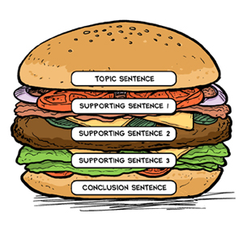
Writing main body paragraphs
Topic (first)sentence:
main idea of the
paragraph
Supporting sentence:
gives details about/
explains topic sentence
Concluding (last)
sentence: repeats the
main idea/gives final
comment about topic
Topic
Expand
Example
Analysis

Slide 25
Writing concluding paragraphs
The clincher
10% of word count
Summarise main arguments/themes
State general conclusions
Make it clear why conclusions are significant
Refer back to question/directly answer it
Make recommendations or suggest way forward/further research
Do not present new material/ideas in your conclusion

Slide 26
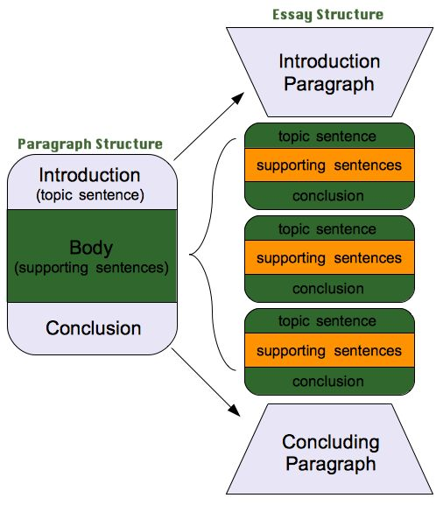

Slide 27
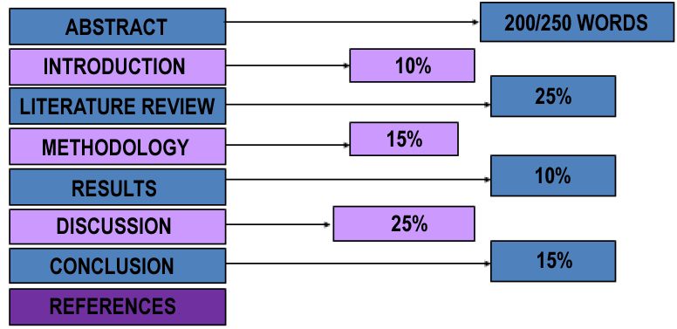
Dissertation structure

Slide 28
Useful reading for academic writing
Biddam, J. (2014), Succeeding with your Master's Dissertation: A
Step-by-Step Handbook (3rd edition)
Cottrell, S. (2013) The Study Skills Handbook (4th edition)
Crème, P. (1997) Writing at University
Greetham, B. (2008) How to write better essays (2nd Edition)
Hart, C. (2004), Doing Your Masters Dissertation
Northedge, A. (2007) The Good Study Guide
Peck, J. & Coyle, M. (2005) Write it Right: A Handbook for Students
Redman P (2001) Good Essay Writing
Rose, J. (2007) The Mature Students Guide to Writing (2nd edition)

Slide 29
Useful websites for academic writing
Get ahead Stay ahead interactive tutorials
http://www.bbk.ac.uk/mybirkbeck/get-ahead-stay-ahead/writing
http://www.bbk.ac.uk/mybirkbeck/get-ahead-stay ahead/writing/structuring_writing
http://www.bbk.ac.uk/mybirkbeck/get-ahead-stay-ahead/writing/referencing
Website supporting the Palgrave study skills books
https://he.palgrave.com/studentstudyskills/page/Writing-and-Referencing/
Useful listening
https://he.palgrave.com/studentstudyskills/resources/images/Write%20it%2
0Right_Tricks%20of%20the%20Trade%20edited%20v2.mp3
https://he.palgrave.com/studentstudyskills/resources/images/referencing.mp3
OU - range of help with academic skills, including writing
http://www2.open.ac.uk/students/skillsforstudy/postgraduate-study-skills.php
Royal Literary Fund - help with dissertation
http://www.rlf.org.uk/resources/introduction-dissertation/

Slide 30
Recap
Importance of writing the way ‘they’ want
What is the ‘proper way’?
- conventions of academic writing
The writing process
Writing an essay
- analysing the question
- writing introductory, main body and
concluding paragraphs
Writing a dissertation

