Slide 1
GET AHEAD UNDERGRADUATE SUMMER PROGRAMME 2016
Get Ahead in your first year
Sara Steinke s.steinke@bbk.ac.uk

Slide 2
Aims
Introduction to this series of academic skills workshops
Find out what to expect in your first year at Birkbeck
Explore how you might be feeling about studying/returning to education
Identify the knowledge and skills that you bring to your studies, and consider how to turn these qualities into academic skills

Slide 3
Class activity
Introduce yourself to another student, and find out what course they are undertaking.
Find out the factors involved in their decision to study a particular course at Birkbeck.
Job opportunities/promotion/change of career
Desire to return to learning
Financial concerns
Time constraints
Course subject
Birkbeck’s reputation/location/time

Slide 4
Get Ahead
5 September - Staying Organised
12 September - Reading and Note-taking for academic purposes
19 September - Critical Thinking
26 September - Academic Writing
Mondays 6.30-8pm in B35

Slide 5
“... those generic and transferable skills which underpin the learning development of undergraduate and taught postgraduate students in HE, enabling them to be confident, independent critical thinkers and reflective learners.” (Leeds University Library, 2010)

Slide 6
Cottrell, S. The Study Skills Handbook
C - Creative
have the confidence to use your individual strategies and styles, apply
imagination to your learning
R - Reflective
sit with your experience, analyse and evaluate your own performance
and draw lessons from it
E - Effective
organise your space, time, priorities, state of mind and resources to
the maximum benefit
A - Active
be personally involved, do things, physically and mentally in order to
make sense of what you learn
M - Motivated
be aware of your desired outcomes using short and long-term 'goals'

Slide 7
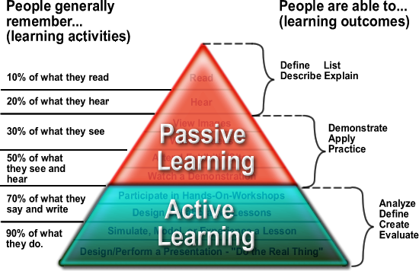

Slide 8
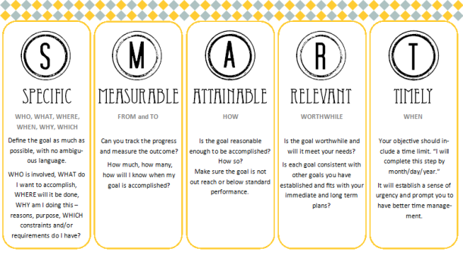

Slide 9
Importance of academic skills
Crucial to being an efficient, effective, active
learner
Interrelated
Go hand in hand with academic content
Transferable to the workplace - soft employment
skills
Expected of you in Higher Education

Slide 10
Our expectations
Attend lectures/seminars punctually
Meet assessment deadlines
Be prepared to work with other students
Be prepared to participate in seminars
Take responsibility for your learning inside and outside the classroom; ask for help if you are experiencing difficulties
Develop your topic knowledge - concepts, debates, specialised vocabulary
Engage with academic skills

Slide 11
What are your expectations?

Slide 12
Accept new challenges
“The student is perforce (necessarily) required to venture into new places, strange places, anxiety provoking places. This is a part of the point of higher education. If there was no anxiety, it is difficult to believe that we could be in the presence of a higher education.” (Barnett 2007: 147)

Slide 13
Common feelings about studying -which apply to you?
I am not sure that I will be able to find enough time for study.
I am worried about meeting deadlines.
I am looking forward to the challenge of
studying again and meeting new people.
4 I have not written an essay for a long time and
am anxious about putting pen to paper.
I am concerned that I will find the work too difficult.

Slide 14
Think about the following
What opportunities are their to turn your personal qualities into academic skills?
People - eg ability to get on with people from different backgrounds; teamwork; ability to see and understand other people’s points of view
Activities - eg managing change and transition; setting priorities; organising work to meet deadlines
Personal qualities - eg ability to recognise your own needs and ask for help; ability to set your own goals; maintaining a high level of motivation

Slide 15
Recap
Introduction to this series of academic skills workshops
Find out what you can expect in your first year at Birkbeck
Explore how you might be feeling about studying/returning to education
Identify the knowledge and skills that you bring to your studies, and consider how to turn these qualities into academic skills

