Slide 1
GET AHEAD
UNDERGRADUATE SUMMER PROGRAMME 2016
Get Ahead in staying organised
Sara Steinke
s.steinke@bbk.ac.uk

Slide 2
Aims
Importance of starting - and staying - organised in your studies
Where does your time go?
How well do you use your time?
What is meant by time management?
Time management techniques
- how to prioritise tasks
- using a diary effectively
- establishing a study timetable

Slide 3
Where does your time go?
What current pressures are there on your time?
Have you thought
about how you
are going to fit
studying into
your wider
schedule?
Can you foresee
any problems
which may arise?
Studying lectures,
reading,
writing
sleeping/
eating
home/
personnel
socialising
work
travel
exercise/
relaxation

Slide 4
Why start organised?
Poor time management and organisational skills prevents students from achieving their best - not lack of ability
"Time management is the skill which above all others can make the difference between graduating and drop out.” Pickford, R. & Brown, S.
Related to other academic skills
dedicated study space/resources, managing the
writing process, giving a presentation, revision and exam strategies, reading and note making for academic purposes
Helps you to set and achieve your goals
Transferable soft employment skills

Slide 5

How well do you use your time?

Slide 6
What is time management?
Time management is about organising your
competing priorities in the limited time
available
Time management often has very little to do
with time
It is about organising your life around what is
important to you, dealing with and confronting
more emotional issues like fear, inadequacy and
other people’s demands on you

Slide 7
Time management techniques
1. Use small pockets of time and take breaks
Recognise and deal with procrastination and perfectionism
Educate your family, friends and colleagues to respect your study space/time
Invest in your academic skills
Identify your time wasters/distractions
Learn how to prioritise tasks
Use one diary to create a ‘to-do’ list
Establish a study timetable

Slide 8
Common distractions/time wasters - which apply to you?
Procrastination/Perfectionism
Social media (Facebook/Twitter/Instagram) and Internet (emails, surfing)
Lack of priorities and setting of goals
Socialising (too much) and intrusions (visitors, calls)
Excessive family demands (children, elderly parents)

Slide 9
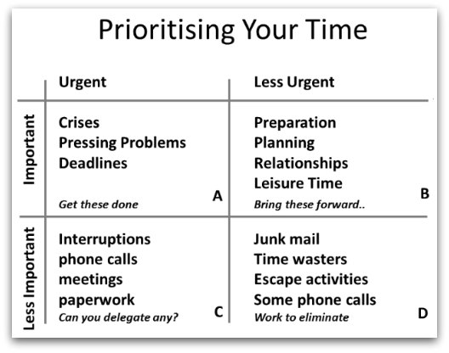
What is prioritisation?
Quadrant A - Urgent and Important
The Quadrant of Necessities -
reactive approach to tasks that need
to be done
Quadrant B - Important but not
Urgent
The Quadrant of Quality - proactive
approach to tasks that need to be done
Quadrant C - Urgent but not Important
The Quadrant of Deception - where
has the time gone?
Quadrant D - Neither Urgent or Important
The Quadrant of Waste - can involve time
wasters

Slide 10
List of things to do | A Importance Need to do scale 6 (unimportant) to 10 (essential) | B Urgency Do now scale 1 (must be done at once) to 5 (it can wait) | C Subtract the score in column B from column A. The higher scores in column C are priorities. | D Order of priority
1. Submit your essay for today’s deadline
2. Start to prepare your presentation for next week
3. Your sick child requires an urgent doctor’s appt.
4. Read agenda and minutes for work meeting tomorrow
5. Book holiday for next summer

Slide 11
List of things to do | A Importance Need to do scale 6 (unimportant) to 10 (essential) | B Urgency Do now scale 1 (must be done at once) to 5 (it can wait) | C Subtract the score in column B from column A. The higher scores in column C are priorities. | D Order of priority
1. Submit your essay for today’s deadline | 10 | 1 | 9 | 1
2. Start to prepare your presentation for next week | 8 | 3 | 5 | 3
3. Your sick child requires an urgent doctor’s appt. | 10 | 1 | 9 | 1
4. Read agenda and minutes for work meeting tomorrow | 9 | 2 | 7 | 2
5. Book holiday for next summer | 6 | 5 | 1 | 4

Slide 12
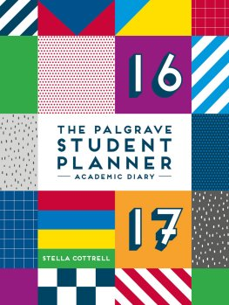
Use one diary, carry with you at
all times, check diary everyday
Enter deadlines, lectures -
include extra time needed to
complete these tasks
Do not schedule 100% of your time, allow for emergencies
Plan time for family, friends
Create to-do list using prioritisation
Record follow up tasks

Slide 13
Advantages of a ‘to do list’
Helps you to decide priorities
Less likely to forget tasks
Shows you the bigger picture
Less likely to become side-tracked
Feel rewarded when ticking off completed tasks
Feel more in control of your work and life
Have a record of what you have done
Always have something to work on

Slide 14
 | Mon | Tues | Wed | Thurs | Fri | Sat | Sun
am 8-12 | Gym/ Work | Work | Gym/ Work | Work | Work | House work and errands | House work and errands
pm 12-6 | Work | Work | Work | Work | Work | Study | Family/ Friends/Fun
Eve 6-9 | BBK | BBK | BBK | Gym | Family/ Friends/Fun | Study | TV
Night 9-12 | TV | Library | Key reading | Key reading | Family/ Friends/Fun | Family/ Friends/Fun | TV

Slide 15
Help is available
Cottrell, S. (2013) The Study Skills Handbook
chapter 1 ‘Managing yourself for study’
http://www.bbk.ac.uk/mybirkbeck/get-ahead-stay-ahead/academic-support/organisational-skills 20 minute interactive tutorial
https://he.palgrave.com/studentstudyskills/page/skills-and-techniques/
helpful information on organisational skills
http://www.bbk.ac.uk/mybirkbeck/studyskills/course timetable
academic development workshops dealing with
organisational skills - and other study skills - in
greater detail

Slide 16
Recap
Importance of starting - and staying - organised in your studies
Where does your time go?
How well do you use your time?
What is meant by time management?
Time management techniques
- how to prioritise tasks
- using a diary effectively
- establishing a study timetable

