Slide 1
GET AHEAD
UNDERGRADUATE SUMMER PROGRAMME 2016
Get Ahead in undergraduate reading and note-taking
Sara Steinke
s.steinke@bbk.ac.uk

Slide 2
Aims
Identify the common problems students encounter when reading and note-making for academic purposes - and which apply to you
What is meant by active reading strategies and note-making methods - and how they can help you to cope with the large amount of reading and increase your understanding of the reading

Slide 3
Common difficulties with reading for academic purposes.
Which apply to you?
I spend too much or too little time reading.
I do not understand the material.
I find the language/specialised vocabulary used too complicated.
I can not remember everything I read.
I find the amount of reading overwhelming.

Slide 4
What is active reading?
Active reading simply
means keeping focussed
on the material . . . your
time spent reading is
more efficient, and that
you're more likely to
remember what you've
Read . . . Active reading
will also help you to form
your own opinions as you
go along.
http://www.humanities.manchester.ac.uk/studyskills/essentials/reading/active_reading.html
Active reading simply
means reading something
with a determination to
understand and evaluate
it for its relevance to your
needs . . . Actively and
critically engaging with
the content can save you
time.
http://www2.open.ac.uk/students/skillsforstudy/active-reading.php

Slide 5
Importance of active reading
Uses smart reading techniques
Engage intellectually with what you are reading - essential for critical thinking
Selective use of your reading lists - essential v. background reading - and material
Crucial for an academic writing style
Encourages active note-making techniques
Soft employment skill - transferable to the workplace

Slide 6
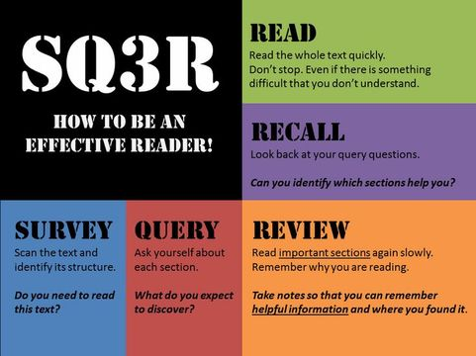

Slide 7
Scanning (to get particular information from a
text) - scan text quickly to locate specific words/
phrases and layout e.g. headings, sub-headings,
images, author’s name/affiliation, contents page,
index for specific words
Skimming (to get a general idea of the text) -
read quickly prior to in-depth reading for
indication of scope/content of text e.g. read first
and last paragraphs to get main points, look at
first sentence of each paragraph to identify
content of paragraph, note key points in summary

Slide 8
Useful resources (reading)
http://www.bbk.ac.uk/mybirkbeck/get-ahead-stay-ahead/academic_skills/reading
https://he.palgrave.com/studentstudyskills/page/reading-and-research-strategies/
http://www.bbk.ac.uk/mybirkbeck/get-ahead-stay-ahead/academic_skills/your-reading-list
http://www.bbk.ac.uk/mybirkbeck/get-ahead-stay-ahead/writing/referencing
http://www2.open.ac.uk/students/skillsforstudy/active-reading.php
Cottrell, S. (2013) The Study Skills Handbook chapter 6
‘Core research skills: Reading, note-making and
managing information’ pp.153 to 186
Northedge, A. (2005) The Good Study Guide chapter 5
‘Reading’ pp.101-128

Slide 9
Common difficulties with note-making for academic purposes
Which apply to you?
I try to take down everything that is said/on the PowerPoint presentation in lectures.
I am uncertain what the purpose of note-taking is.
I am unsure what to make notes on.
I do not take time to organise my notes so that I can retrieve them later on.
5. I only know one way for note-taking.

Slide 10
Think about the following
Note-taking is when you are
taking notes on material in
class; on what a speaker is
saying; on what is happening
around you.
Note-making is when you
make notes on your thoughts;
things you think you should
study for, or remember; your
own individual thoughts or
information that you recall,
and want to write down to
remember or study.
What is the difference
between note-taking
and note-making?

Slide 11
Importance of active note-taking
Avoid unintentional plagiarism
Focus on what is important
Understand and remember material, and make connections
Personal record of what you have learnt, your questions and ideas
Sets you up for exam revision
Encourages you to organise and condense your notes
Encourages you to ask critical questions

Slide 12
Note-making from lectures
Before | During | After
Read recommended reading before the lecture - what do you already know about the topic? Is the topic new to you? | Listen/watch for verbal transition cues and non-verbal signs from lecturer | Summarise what you have learnt - this helps your understanding and memory of the topic
Print out the lecture slides or hand-outs before the lecture | Identify key words and specialised vocabulary | Follow up what is important - reading, questions
Anticipate main points and structure of lecture - and how the topic connects to the rest of the module | Be an active listener | File notes - useful for revision purposes

Slide 13
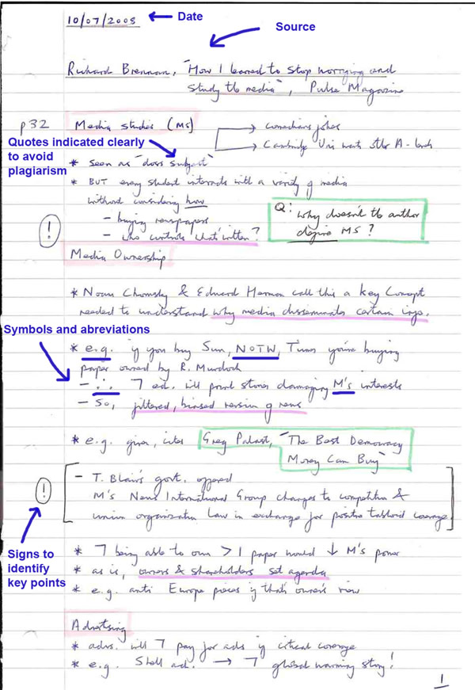
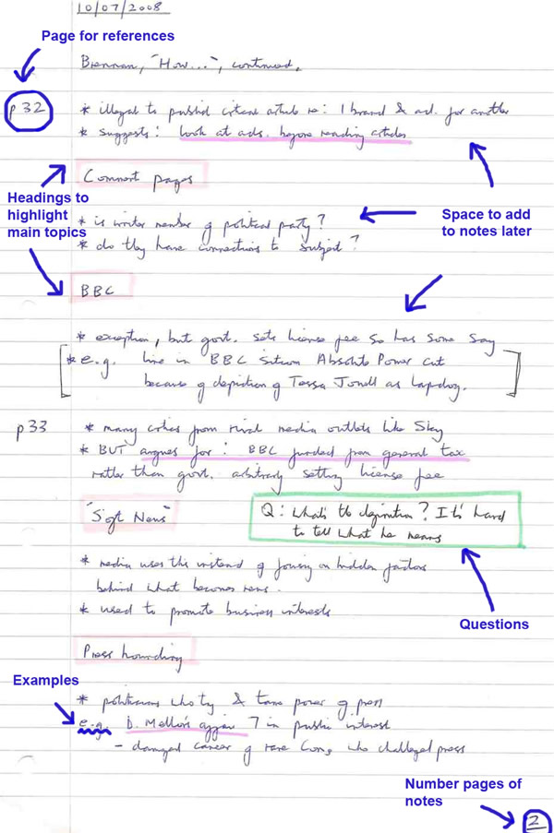
Linear notes

Slide 14
Linear notes
Use headings - main ideas and concepts
Use subheadings - points within those ideas
Number the points - to keep organised
One point per line
Underline, colour, use capital letters for emphasis
Use abbreviations - =for equal, <less than,
>more than, re regarding, cf compared with
Leave space - for adding detail, thinking

Slide 15
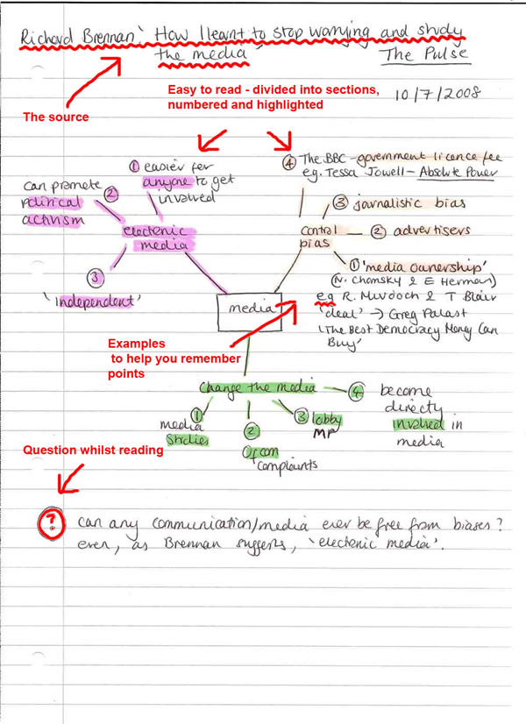
Mind map

Slide 16
Mind map
Turn the paper sideways, A3 landscape
Write the topic in the centre of the page
Write related ideas around this centre
Add secondary ideas to the main ideas
Link up these ideas to show relationships
Use colours, different line thickness, symbols, pictures

Slide 17
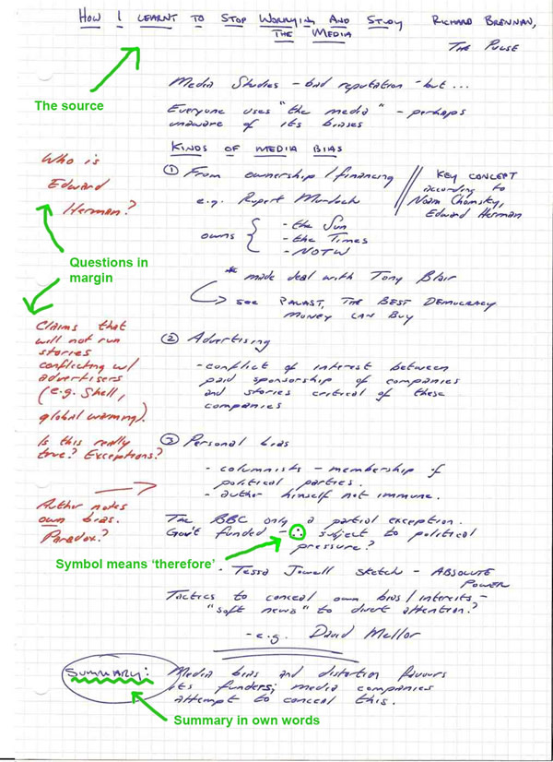
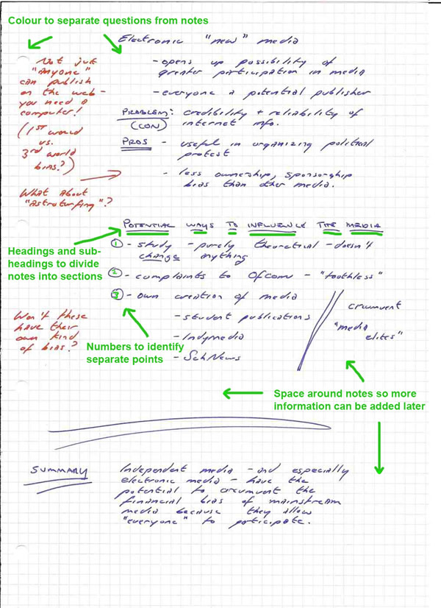
Cornell system

Slide 18
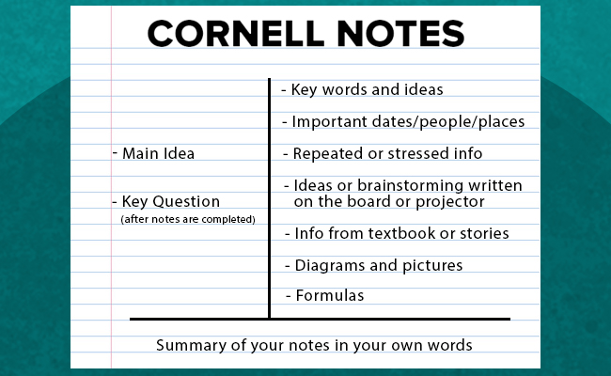

Slide 19
Workshop activity
London's Black history
https://www.youtube.com/watch?v=BA4e7JH-vFs
Select a note-taking technique, and use it to make notes on the above mini-lecture.

Slide 20
Useful resources (note-making)
Cottrell, S. (2013) The Study Skills Handbook chapter 6
‘Core research skills: Reading, note-making and managing
information’ pp.153 to 186
Northedge, A. (2005) The Good Study Guide chapter 6
‘Making notes’ pp128-156
https://he.palgrave.com/studentstudyskills/page/making-notes/
http://www.bbk.ac.uk/mybirkbeck/get-ahead-stay-ahead/academic_skills/note-taking-
skills
https://www2.open.ac.uk/students/skillsforstudy/notetaking-techniques.php

Slide 21
Recap
Identify the common problems students encounter when reading and note-making for academic purposes - and which apply to you
Recognise what is meant by active reading strategies and note-making methods - and how they help you to cope with the large amount of reading and increase your understanding of the reading

